Slide 1
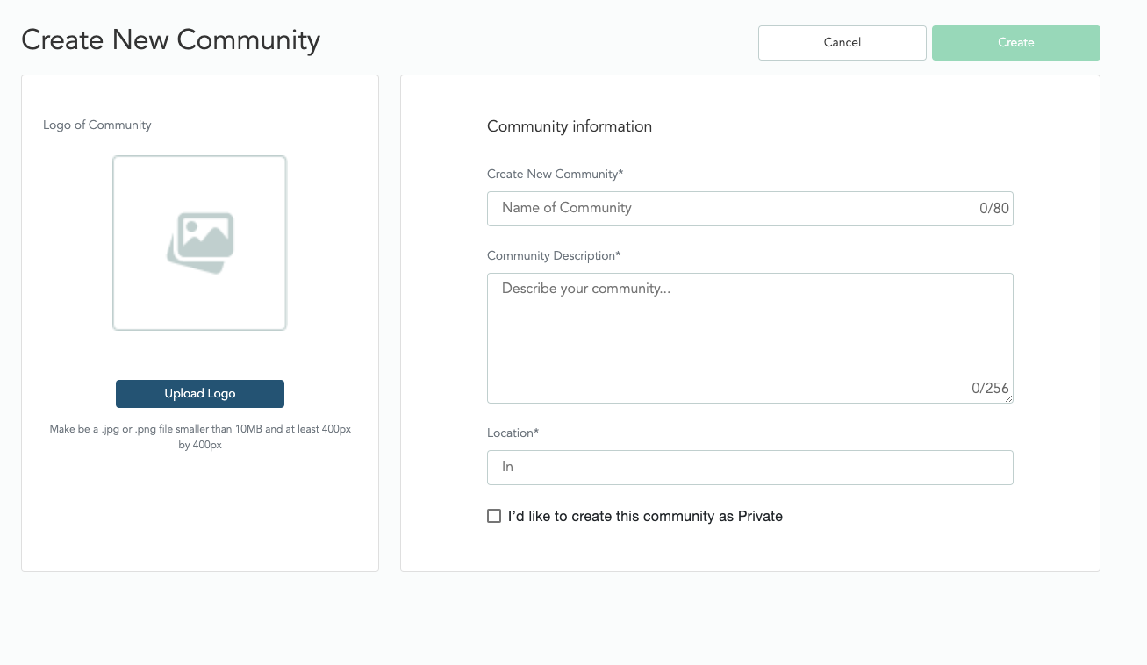
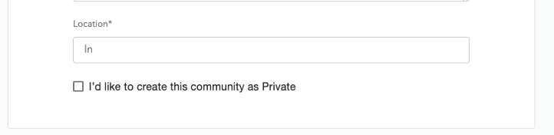
category
sub-category

Slide 2
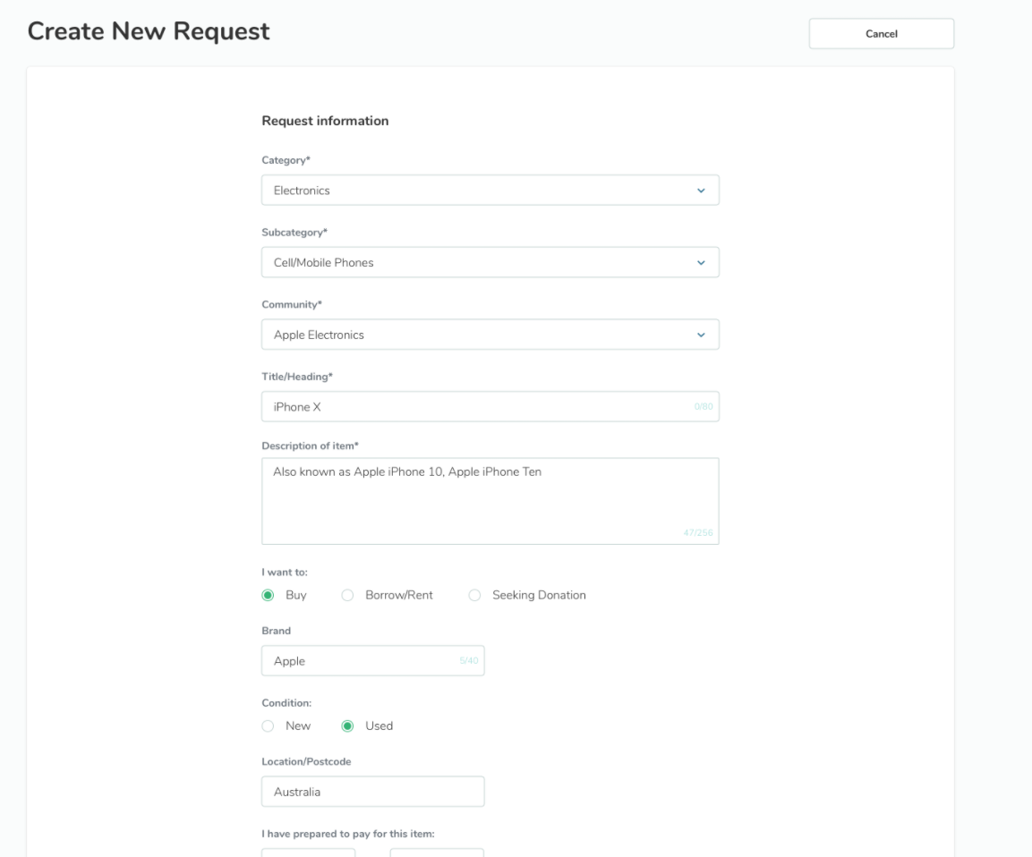
when creating a request from with a community – the fields
* community
* category
* subcategory
would be pre-populated based on the details registered when the Community was created
Community
Category
Sub-category

Slide 3
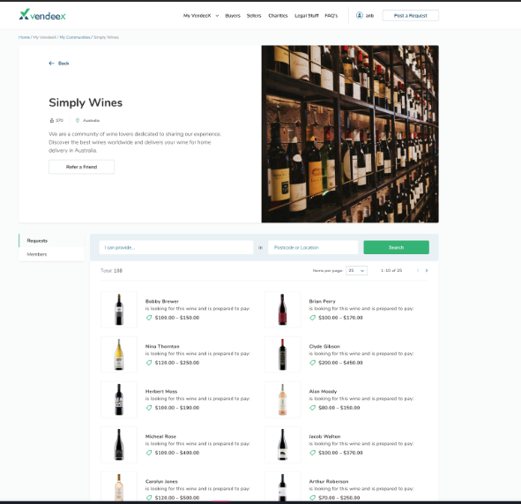
what are your thoughts?
when inside the community, should we position the "post request" so that it is more clearly in the community?
post request

